Slide 1

MOCKUP

Slide 2
Registration/Login in
Little Planet
welcome
Email Address
Password
Login
Create a new account
Forget password
version

Slide 3
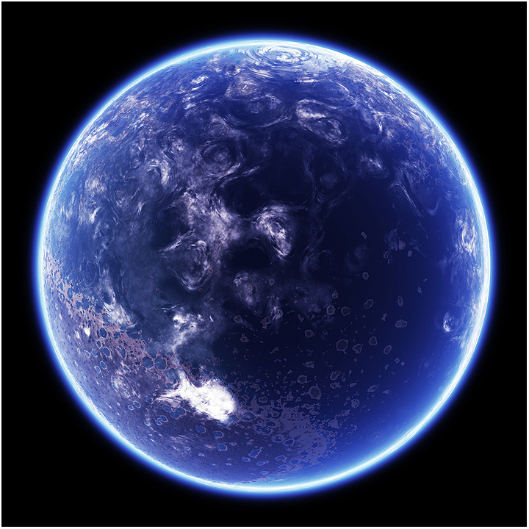
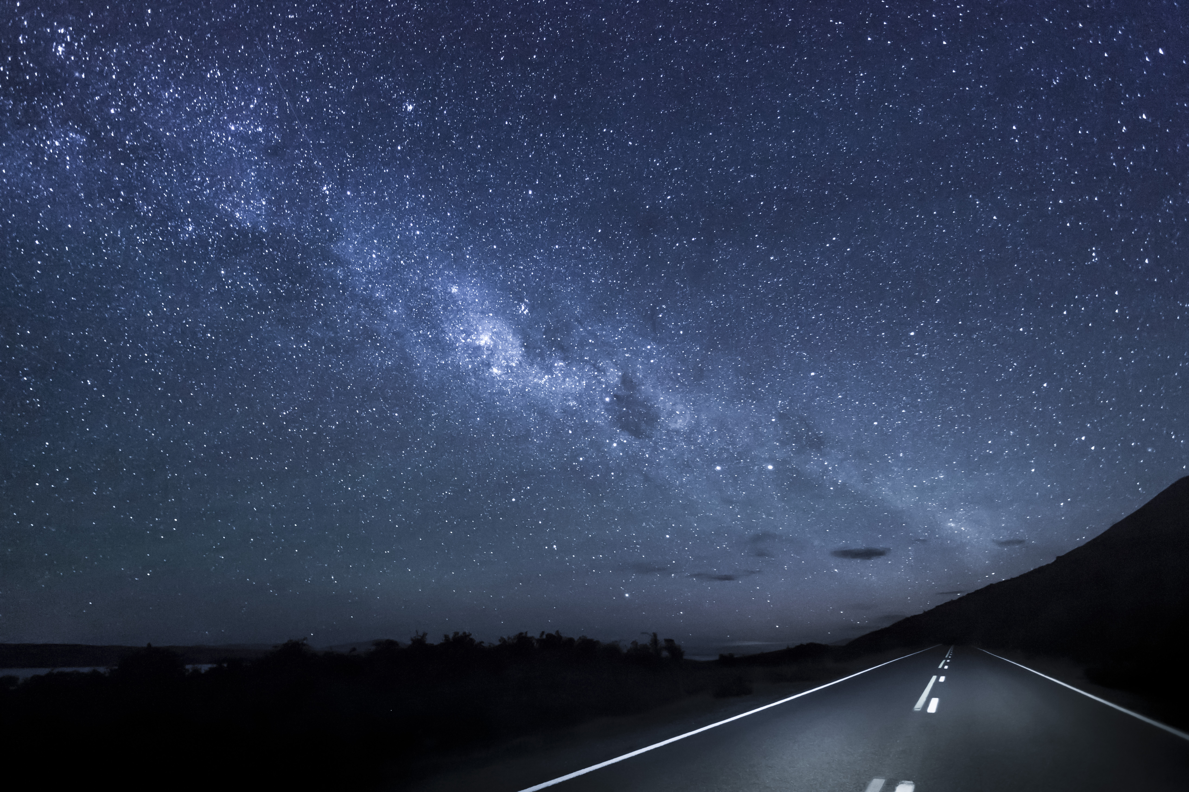
Planet View
Pic Copyrights:
This Photo by Unknown author is licensed under CC BY-NC.
Planet View (Main interface)
Total goals achieved:
//Countries in your planet:
//Cities in your planet:
The navigation bar:1. Main 2. Goal Setting 3. Progress Tracker 4. Achievement
The navigation bar

Slide 4


Goal Setting
Write down your goal!
Name : _________________​
Duration : From DD/MM/YY​
To DD/MM/YY
​Details : _________________
_________________​
//Comment : _________________
_________________
_________________
Duration: How many days do you want to spend on forming this habit.
return
confirm
The navigation bar

Slide 5
Progress Tracker 追踪进度
Title: Track Your Progress
This second interface on this page contains all the information users have inputted from the previous goal setting page.
Goal 1
Title: Track Your Progress
Goal:
Time(Start & End Time):
Progress: (If progress tracker bar completed, jump out the next page)
Details:
Click Suspend
Goal 2
Goal 3
(The background is the reward image)
Load more items
The navigation bar
The navigation bar

Slide 6
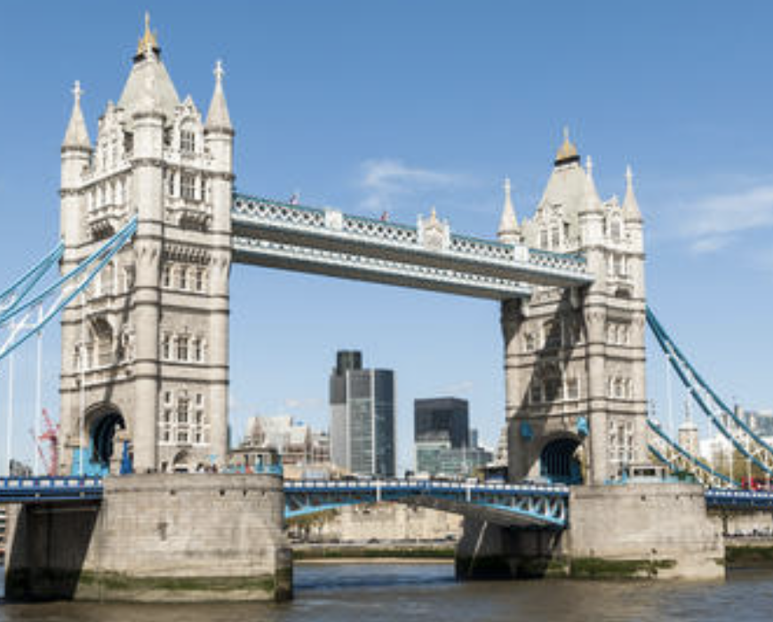
Collection of pictures
Congratulations!
You have completed a goal!
Collection
The navigation bar

